Slide 1
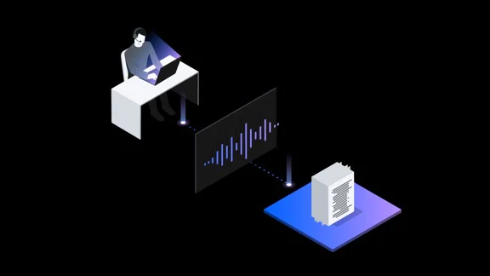
AUTOMATED NOTES MAKER
FROM AUDIO RECORDINGS
DEPARTMENT OF COMPUTER TECHNOLOGY
TEAM : SMART TECHIES
TEAM MEMBERS:
JAISHREE B (212CT116)
DIVYAJOTHI M (212CT109)
PRAVEEN A (212CT142)

Slide 2
ABSTRACT:
The project is a real time speech to text conversion system with more accuracy as the user pronounces.
In our application the words are made into text file.
The text file is mailed to the registered user , which can be used for further reference. The application can be used in all operating systems.
The project aims to provide students with text based PDF/Word Document of their online classes given they are voice based in nature.

Slide 3
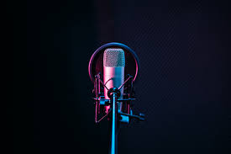
AGENDA:
Abstract
Technology stock
Use case
Methodology
Advantages
References

Slide 4

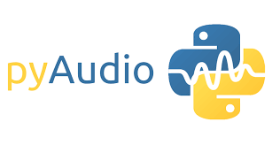
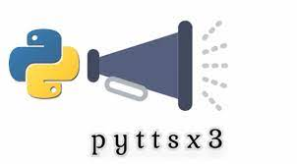

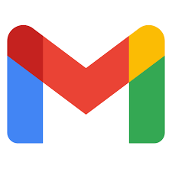
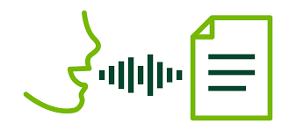
TECHNOLOGY STOCK:
AUDIO
.mp3 to .wav
Google API
SMTP
Create
doc / write
Send email to respective person
Checks similarity

Slide 5
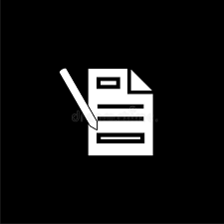
USE CASE :
AUDIO
Existing file upload
Submit to server
Records live audio
Recording convert to .wav format
Text document output
.wav file input to speech engine
Mail text document to registered mail

Slide 6

METHODOLOGY
The backend and UI of this project are
Backend: python
UI:PHP
Existing Libraries
pyttsx3
pyAudio
Speech Recognizer

Slide 7
Advantages :
Language independent.
Application can convert old speech recordings into texts and even live conversions.
Accuracy check.
Text document mailed to the user for further references.
Main targets are making notes of conferences, online classes and board meetings.

Slide 8
References:
[1] Deepa V.Jose, Alfateh Mustafa, Sharan R,”A Novel Model for Speech to Text Conversion” International Refereed Journal of Engineering and Science (IRJES)ISSN (Online) 2319-183X, Volume 3, Issue 1 (January 2014)
[2] Ibrahim Patel, Dr. Y. Srinivas Rao, “Speech Recognition using HMM with MFCC-an analysis using Frequency Spectral Decomposition Technique” Signal and Image Processing : An International Journal(SIPIJ), Vol.1, Number.2, December 2010

Slide 9


